Slide 1

MLSA Full Stack Development Internship

Slide 2
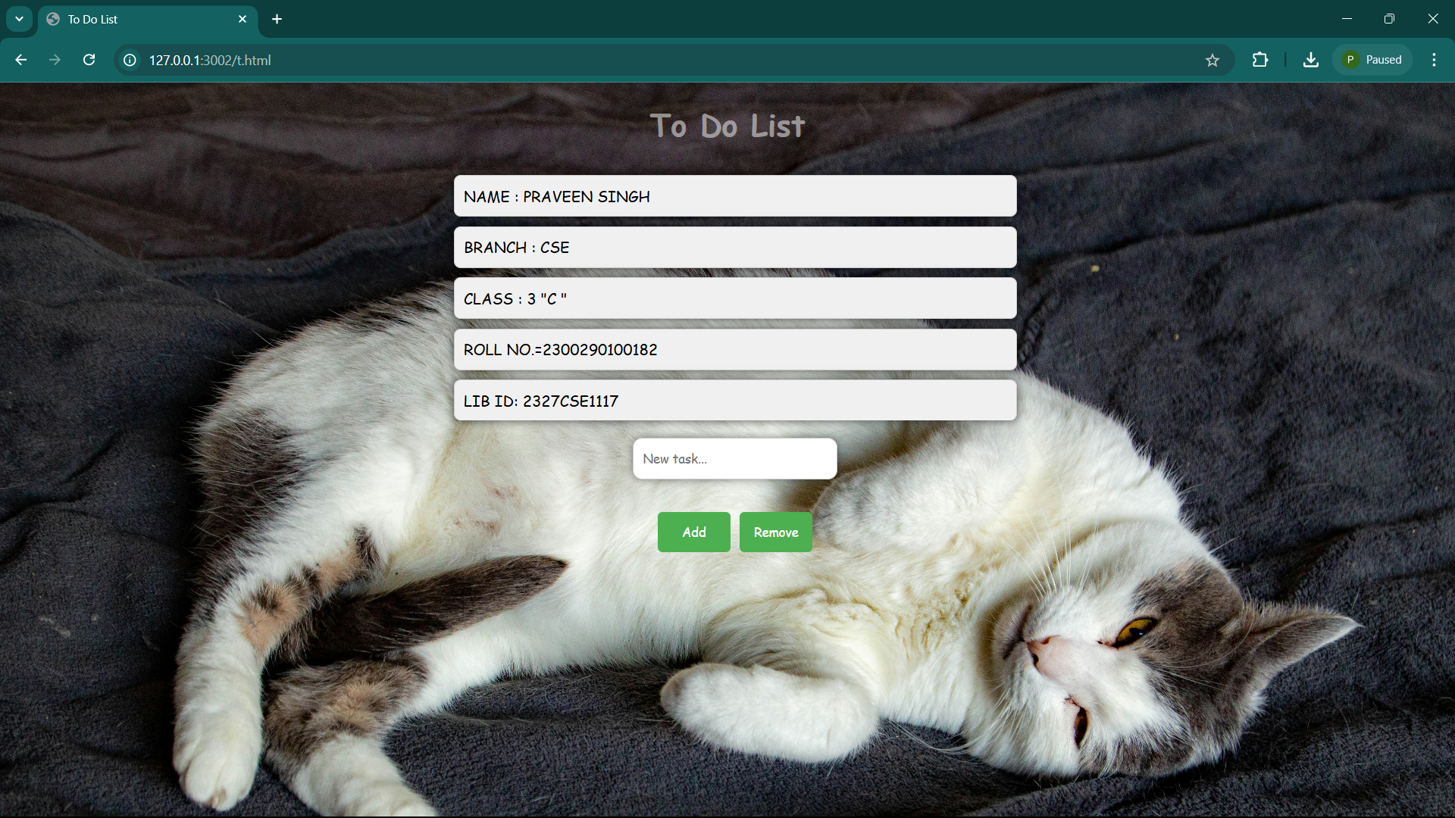

Slide 3
Internship Overview
Objective
Skills
Projects
Gain hands-on full-stack development experience
Strengthen HTML, CSS, and JavaScript foundations
Personal Webpage and Calculator Application

Slide 4
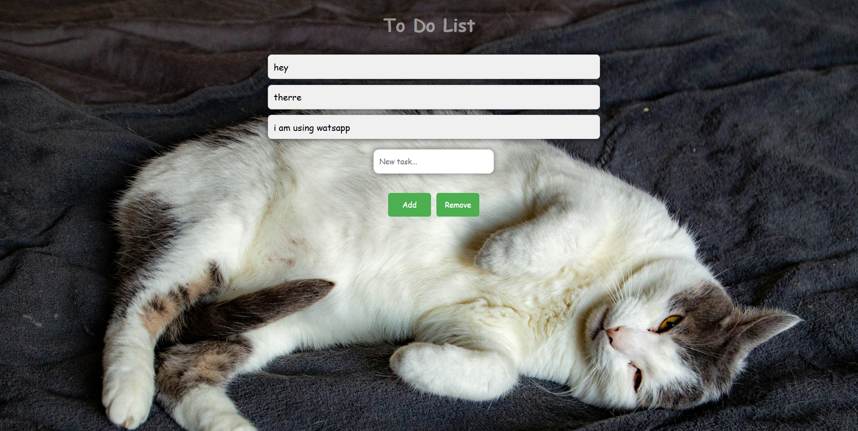
Project 1: Personal Webpage
1
Objective
2
Components
To-do list implementation
Adding and removing elements from the list in LIFO format.

Slide 5
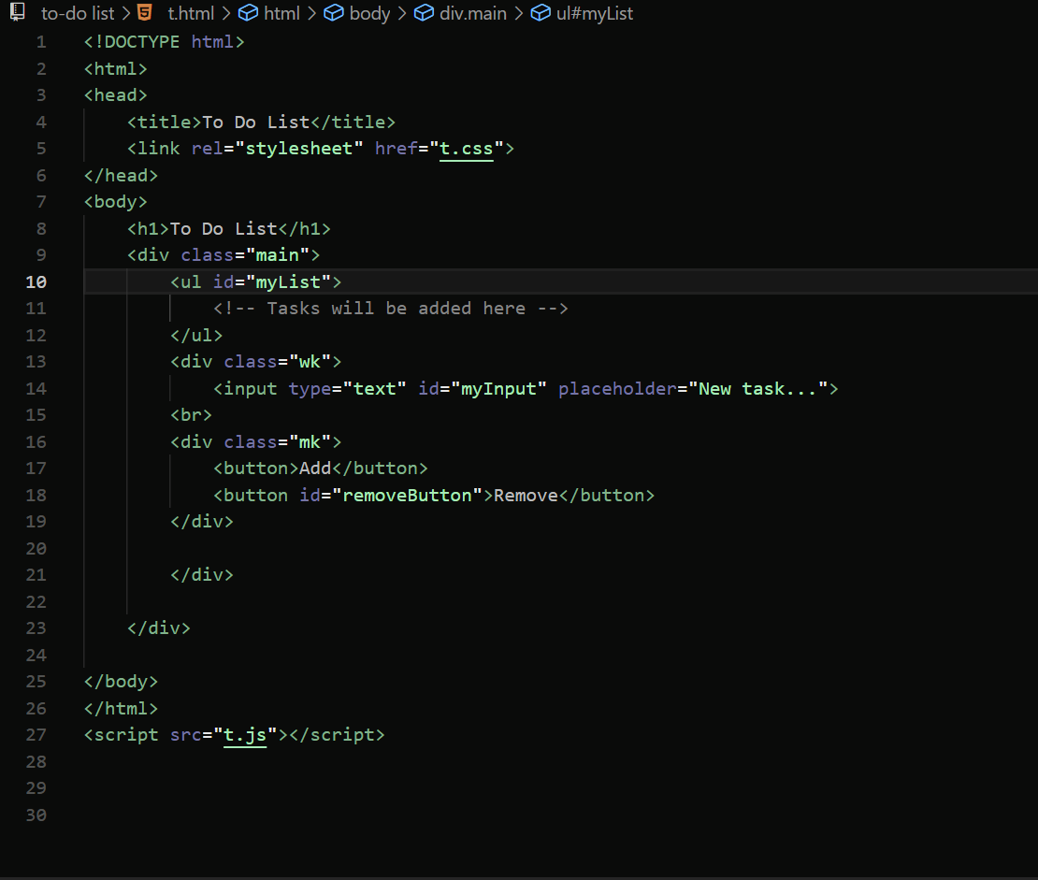
Project 1: Implementation
1
HTML
created a input tag and “ADD” and “remove” button .
2
CSS
Apply styling
3
JAVA-SCRIPT
Adding functionality to add and remove button ...

Slide 6



Project 1: Key Learnings
HTML Structuring
Semantic elements for better organization
CSS Styling
Enhanced layout techniques and responsive design
JAVA-SCRIPT dynamic changes
Learn to use arrays and loops concept

Slide 7
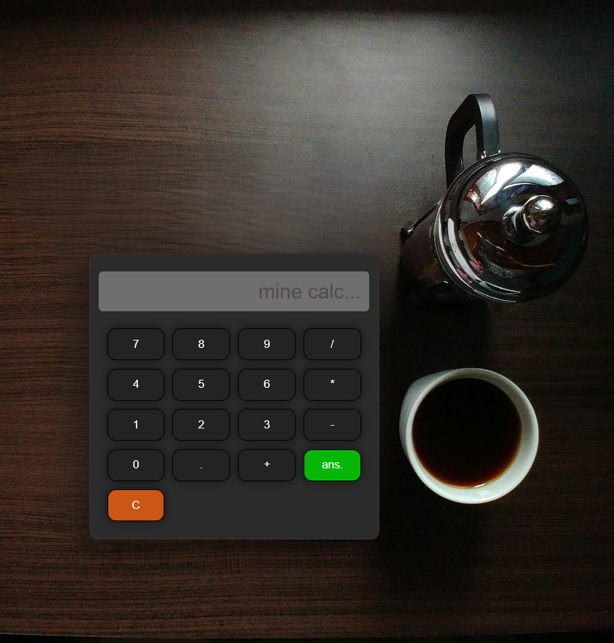
Project 2: Calculator Application
Objective
Build calculator for basic arithmetic operations
Functions
Addition, subtraction, multiplication, and division
Focus
User-friendly interface with real-time calculations

Slide 8
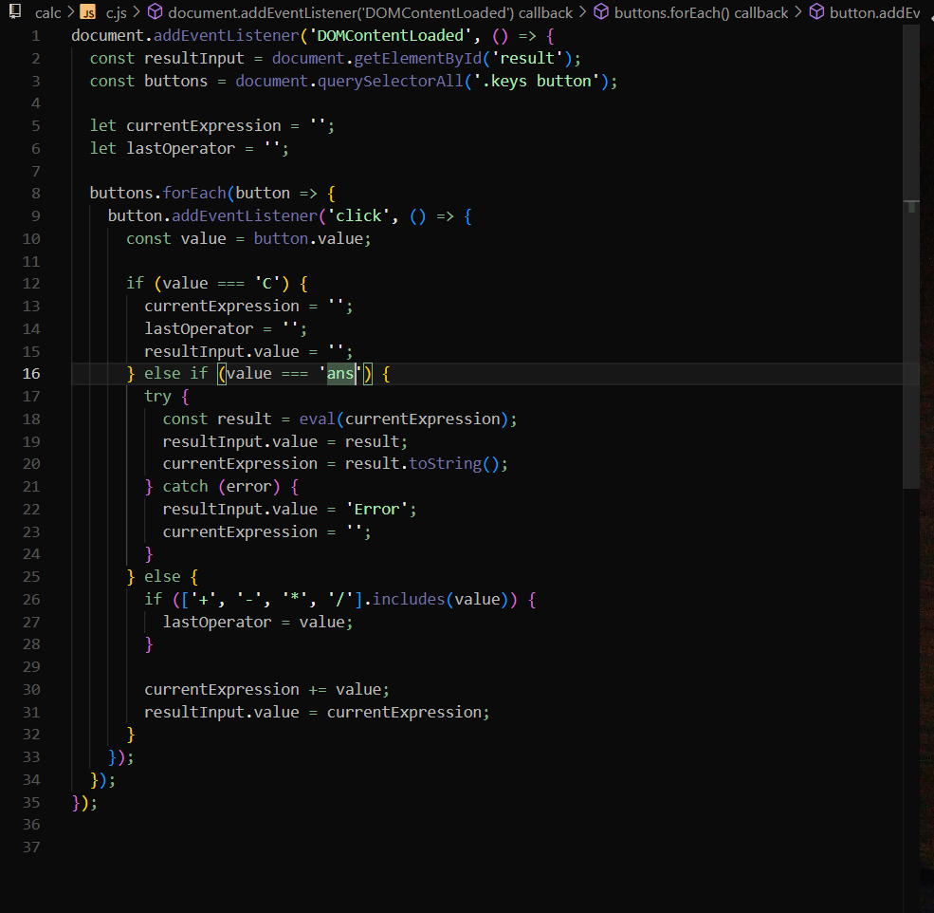



Project 2: Implementation
HTML
Design intuitive calculator interface
CSS
Style for visual appeal and usability
JavaScript
Implement calculations and interactive functionality

Slide 9
Project 2: Key Learnings
JavaScript Functions
DOM Manipulation
Problem-Solving
Efficient handling of arithmetic operations
Dynamic input capture and result display
Debugging and handling edge cases effectively

Slide 10

Overall Internship Experience
1
Skills
Strengthened HTML, CSS, and JavaScript foundations
2
Confidence
Enhanced ability to create interactive web applications
3
Insights
Gained valuable full-stack development workflow experience

